Slide 1

INTRODUCING
Lucan Community College
Information Night for Parents/Guardians of Accepted Applicants 2026/27

Slide 2
Presenter 1
Genevieve Casey
Incoming 1st year induction coordinator

Slide 3
Purpose of Information Evening
Outline the remainder of the Admissions & Options process
Confirm your choice of Lucan Community College for your son/daughter
Notes:
While many of you have already experienced our school through previous children – this year may be a little different – different student may require different supports; a different child has different needs, change in some courses/subjects.

Slide 4

Part 1:
Online pack contents
Líonra - student mentors for 1st year
Assessment 4th/11th February 2026
Attendance & Punctuality
Uniform
Tips for parents of incoming 1st years

Slide 5
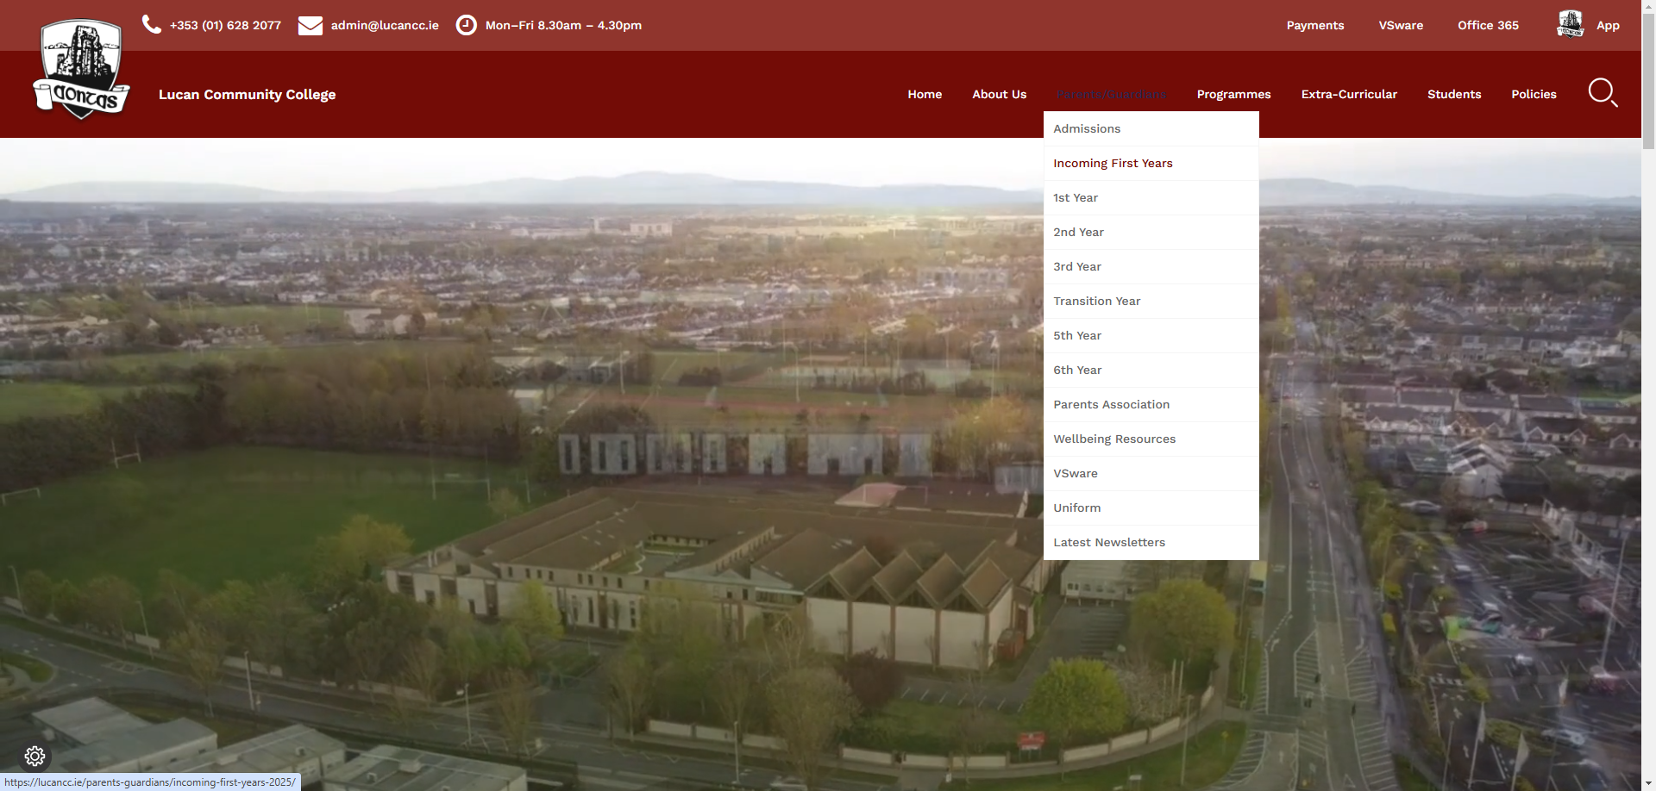
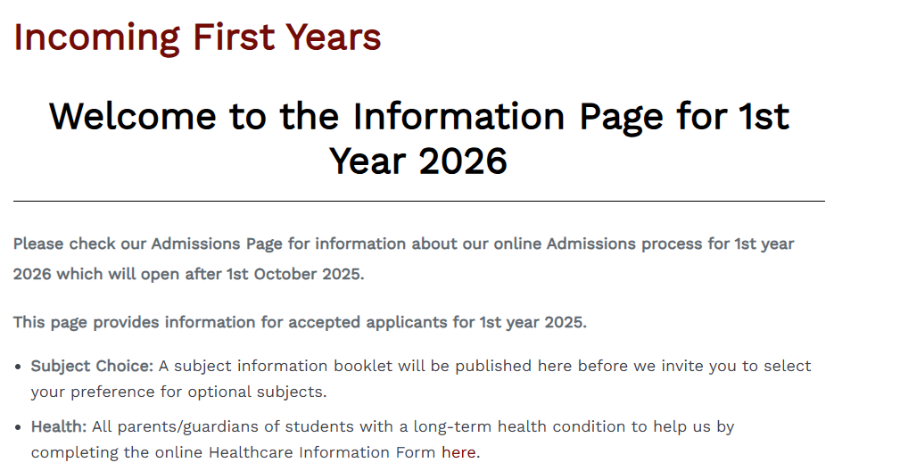
Accessing the Online Information Pack
www.lucancc.ie
Hover over Parents/Guardians
Click Incoming First Years

Slide 6
Online Information Pack –
Various policies that are important to read
AEN & Health Survey: complete if student has AEN diagnosis or chronic (long-term) illness
Slides from information evening
Uniform Details – read and purchase from supplier
Assessment Day 2026
Subject Information and online Subject Option Form – notification will be sent when it is time to complete subject options

Slide 7

Online Information for Incoming First Years: www.lucancc.ie -> Parents/Guardians
-> Incoming First Years
Health survey (for medical conditions)
Lockers & Voluntary Contribution
Advice from other parents
Child Protection Guidelines
Religious Education & Wellbeing subjects explanation
Frequently Asked Questions section

Slide 8


Líonra – Student Leaders
Team of 5th year students supporting first year transition
Building relationships with students in first year
Organising first year events
Outline more & meet the Líonra team in Sep 26.

Slide 9
Incoming Assessment Tests
Tasks involve thinking about shapes and patterns, words, numbers and some questions are answered by mentally generating and transforming visual images.
Provides school with baseline data on student attainment and supports needed.
Tour of schools for students in May by Líonra team
What next?
Request a meeting/phone call through front office if there is something of a sensitive nature that you wish to communicate to the school
Special tour for students with additional needs
Meeting for parents date to be confirmed.
Tests are online and students should bring a wired headset with them (3.5mm jack)
11th Feb All other schools
Assessments – 10.00 -12.30
4th Feb Scoil Aine

Slide 10
Attendance and punctuality
Importance of good and regular parental communication
Please download app when prompted by the school
Parents/Guardians notify the school of absences through Lucan CC school app (day before or before 8am on day of absence)

Slide 11
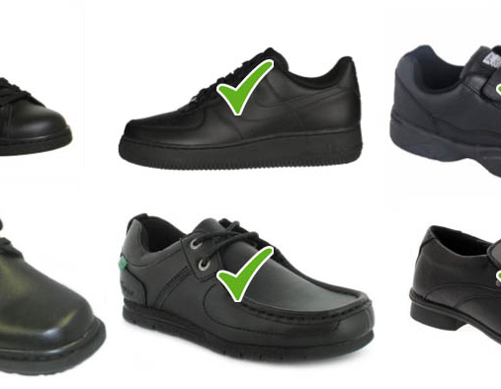
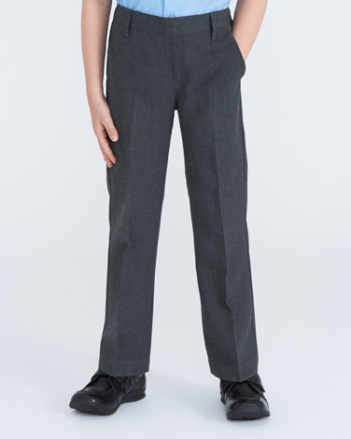
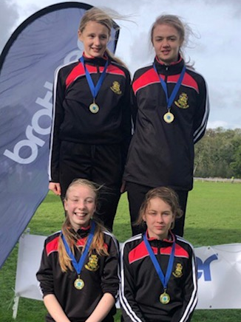

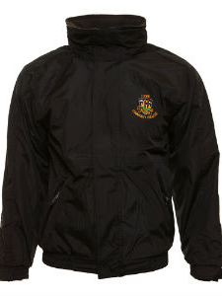

Uniform

Slide 12

Uniform overview
Students wear kilt or trousers
Plain black footwear - this is necessary because we have many outside parts to the school
Compulsory crested school coat – 2 variations (Heavy and Lighter) - cannot wear own coat in-school
PE Uniform:
Crested tracksuit top (School Warehouse only*)
Black Crested Polo Shirt (School Warehouse) or Plain Black T-Shirt (no logo, wording, patterns or other colours permitted)
LCC tracksuit bottoms (School Warehouse) or Plain Black Tracksuit bottoms (no logo, wording, patterns or other colours permitted)
Optional extra – Black LCC Crested Sports Leggings (School Warehouse only*)
Full details of uniform and uniform supplier on website

Slide 13
Tip 2:
Communication
School app notifications – please ensure that you download the school app when we invite you to. Ensure the school has your current mobile number on file for urgent phone calls
Calendar – keep an eye on the calendar (posted/journal/ website calendar/) to see early finishes or days when events are happening

Slide 14

Reporting on Progress
Twice Yearly reports on academic and social progress in school year – usually Christmas and Summer (accessed through VSware system)
Annual Parent Teacher Meeting (short conversation with subject teachers)
Where an issue of serious concern arises, please contact front office to arranged individual teacher/tutor/Year Head meeting with parent

Slide 15

Tips for incoming parents & students

Slide 16
Tip 1: Books/ equipment
Labels
Name – ensure your child’s name is on everything you buy: pencil case, clothes, folders, keys, water bottles, 1000 students
Books
Books and some basic class resources are now covered by the Book Grant Scheme and will be distributed to students before classes start.
Uniform
Uniform is available from suppliers in June/August
Details will be on website – incoming 1st years
Most books are now available online also (code inside) so students can access them when doing homework – reduce weight of bag
€50 deposit if books are damaged – students need to mind the books given to them

Slide 17
Tip 3: Lunch/travel
1st to 3rd year students can stay in for lunch (packed lunch or use school canteen) or go home for lunch. They cannot visit any shops or shopping centre areas (note is signed if leaving school)
Healthy eating policy – please encourage students to eat nutritious lunches and snacks – no peanuts please
Cycling – we encourage students to cycle but please ensure they wear a helmet and lock their bike securely, walk while in school grounds and use a light during darker months
Cars – there is no room for parents to park on-site
Not permitted to drop/collect students from front entrance -> Arrange to meet your child further away from the school entrance

Slide 18
Presenter 2
Kevin Mc Gowan
Deputy Principal

Slide 19
Agenda - Part 2 – K. Mc Gowan
Formation of classes
Subjects and Options Process
Extra- and Co-curricular programme
School App
Inclusion:
English as an Additional Language,
Additional Educational Needs,
Irish Exemptions

Slide 20
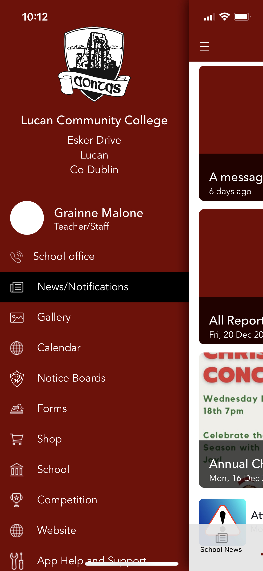

School APP
Features include:
Absence notifications from school
Absence requests from home
Push notifications
School news integration between app, website and social media
Personal notifications specific to each child
Permission Slips
GDPR compliant
Easier school communication – admin support/email etc
Integrated calendar

Slide 21

Formation of classes
Junior Cycle operates with students being placed in two bands of 3 classes - to allow access to a wide range of subjects
Placement in classes is decided based on:
  Consultation with primary school
  Information supplied by parent/guardian
  School resources
  Additional Needs support

Slide 22

Subject levels for Junior Cycle
Students in every class have access to subjects at every level and classes operate on a mixed ability basis
Booklists for all class groups are the same
All subjects now have a common level (except Irish, English and Maths which have Higher/Ordinary levels)
Decisions on level of subject to be taken in Junior Cycle exam is decided in 2nd year or early in 3rd year

Slide 23

Choosing your Option Subjects – the Process

Slide 24
1st Year Subjects September 2025:
Non-choice subjects and Other Learning Experiences (OLEs)
Gaeilge/Irish (for examination unless exempt)
English, Maths
History, Geography
Modern Foreign Language: French/German
Religious Education
Wellbeing: P.E., C.S.P.E. & SPHE
Options (selected online)
Available options include: Applied Technology, Business Studies, Engineering, Graphics, Home Economics, Music, Visual Art, Science and Wood Technology
Advice to Consider
Open Day experience if you attended
School options booklet (online pack)
https://ncca.ie/en/junior-cycle/
Talk to others (present students/parents)
The school is currently conducting its annual curriculum review and if any aspect of the JC curriculum changes we will inform you in advance of the 2026 options process

Slide 25


Online Options process
You will receive a message – with an initial username and link to VSware (our school management software) - this username will change to single family username once your child joins in September 2026 (current or future siblings)
Instructions & demonstration video will be available on the school website
Once you receive your username, options can be entered for one week (7 days to complete this). Options can be changed during this period (software autosaves entries)
You will then choose your option subjects in order of preference – further instructions will be given when curriculum planning is finalised

Slide 26
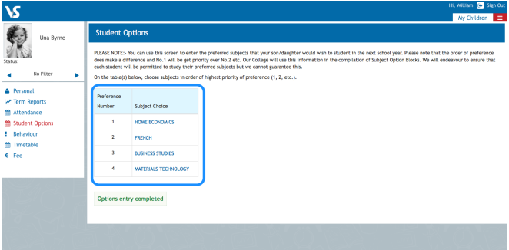
Screenshot of VSware Options

Slide 27
Sample Of Timetabled Options
Line 1 | Graphics | Science | Music | Home Economics
Line 2 | Applied Technology | Visual Art | Business studies | Science
Line 3 | Engineering | Wood Technology | Science | Home Economics
Please note that subjects can clash with each other, and this may affect the subjects you can study.
There is no way to predict this in advance so you should choose subjects order of preference – based on numbers choosing a subject and available resources (teachers/rooms etc).

Slide 28
Important points about options process
Every effort is made to allocate subjects based on student preferences
Due to resource issues (size of classes, staff, specialist classrooms) it is not possible to give everyone their 1, 2, 3.
We will ensure we place sufficient science classes on option lines to serve the needs of everyone who places Science as number 1 on option preference
Efforts made to balance options offered to ensure no one receives the lowest selected preferences
Important that you reflect before deciding your preference on student interest and aptitude, possible career options
Process for addressing option issues can be addressed right up to the start of school term

Slide 29
Inclusion: Additional Education Needs (AEN)
Under the New Model of Allocation of Resources, the school receives a general allocation of hours to support students.
However, we welcome copies of assessment reports as they help inform planning for supports – thank you for uploading them to Enrol – MIT on acceptance
The school also receives a general allocation for SNA support. We need to know of any support received in primary school to enable planning – thank you for sharing this in the survey you completed

Slide 30
Irish Exemption
Circular 0055/2022: Criteria:
students whose education up to 12 years of age was received outside the State for a minimum of 3 years and where they did not have opportunity to engage in the study of Irish
students who are being enrolled after a period (at least 3 years) spent abroad,
students who:
  present with significant learning difficulties and
  at the time of the application for exemption present with a Standardised Score at/below the 10th percentile.
d. students who experience a high level of multiple and persistent needs and who satisfy certain other criteria.
Students will often still attend Irish class and are included in a meaningful way in aspects of Irish language and cultural activities
Thank you for uploading Irish exemption cert from primary school on our acceptance platform
If you think your child should have an exemption, email the office and ask for an application form

Slide 31
Inclusion: Students with English as an Additional Language (EAL)
Possibly eligible for special support:
Applicants whose first language is not English
Applicants who arrived to Ireland and started school after 11th birthday
Please completing the AEN survey as it will also ask about English as an additional language

Slide 32
Presenter 3
Stephen Brett
Principal

Slide 33
Policies
Who we are:
Patron – DDLETB
Board of Management – provides oversight
Active Parents Association – more information to follow
Finances
Core Values
School Evaluation Reports
What we offer

Slide 34

Patron: Dublin & Dún Laoghaire Education and Training Board
Who we are:

Slide 35
Mission, Ethos and Aims
Those parents already with us are familiar with our school ethos – Aontas/Unity and our ETBI values
You can read our Mission Statement on our website:
  Active learning community
  Each person is valued and respected
  Supportive, safe, friendly learning environment
  Diverse curricular and extra-curricular activities
  Full potential of all is developed

Slide 36
About what we offer
Established:
Lucan CC (since 1987) and Vocational School since 1950s
High standards & Excellent track record
Strong extra-curricular programme
Junior & Senior Cycle:
Pathways for new subjects: Politics & Society, LC Physical Education, Computer Science
Technology:
Wireless technology, computer rooms and portable laptop trolleys
Using Microsoft 365 as a teaching and learning platform
Building Plans:
New extension Phase 1 ready for August 2026
Phase 2 of Extension and refurbishment waiting for confirmation by DEY
Phase 2 includes new gym, refurb of whole building
Broad range of options – we aim to meet the needs of our students
Exploring 1:1 devices at senior cycle 2026/27

Slide 37
Recent Lucan CC Inspection Reports
Overall, the quality of leadership of learning and teaching was very good. During the evaluation it was evident that all staff were highly committed to ensuring the realisation of the school’s mission statement and motto ‘Aontas’ (Unity)
Students demonstrated a good understanding of the anti-bullying procedures and staff had formed an anti-bullying team to address any concerns that may be raised.
The care for students was a strength of the school and this was evident in the caring environment and sense of community shared by students and other stakeholders of the school.
Teachers are enthusiastic and reflective practitioners
Students demonstrated a sense of pride in their school.
Student behaviour was exemplary throughout the evaluation. .
See www.education.ie

Slide 38
School Policies
We ask that parents make themselves aware of our main policies.
Policies available on website. New policies developed and existing policies updated regularly – the PA is your means of consulting on various policies and procedures
Admission policy
Child Protection Policy
Code of Behaviour including Anti-bullying/Bi Cineálta policy
School Self Evaluation report
Data Access & Protection
Attendance Policy
Health and Safety
Substance Misuse
Critical Incident Policy
RSE/SPHE
Extra-curricular policy
Inclusion (SEN) Policy
Assessment and Reporting
Staff/parent communication
Pastoral Care guidelines
Suspension and expulsion
Complaints procedure
Internet Acceptable Use Policy

Slide 39
Our Behaviour Policy
  Focus on Positive Behaviour with practical rules
  Procedures exist for student safety, security, parent information and often legal requirements
  Certain items banned e.g. tippex, chewing gum, cameras/recording devices/smart watches.
  Healthy environment: student water fountains, no fizzy/energy drinks, healthy lunches, school canteen, no smoking/vaping
  Use of Phones – banned around school, exceptions only with teacher supervision for specific learning
Teacher-student and student-student interactions: again – our focus is on positive relationships Rights & Responsibilities
Notes:
Have classroom rules to show

Slide 40
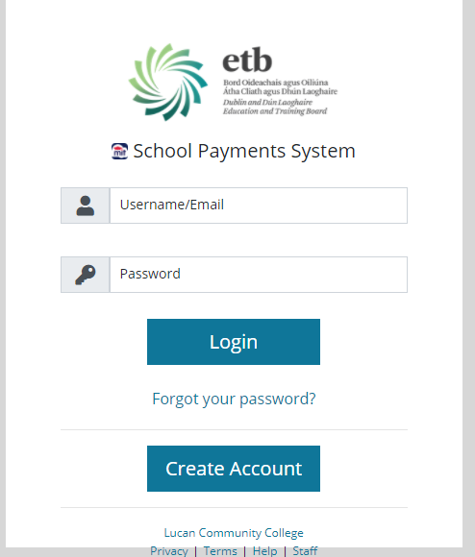
Finances
Department of Education, directly and through ETB, funds basic building costs (heat, lighting etc)
Parental contributions covers:
  Annual €50 admin (24hr insurance, operating costs of the school communication system, locker rental, phone calls and access to IT educational software for all students.
  Annual €90 voluntary contribution to cover all extra-curricular expenses, awards and other student activities and events (reductions for siblings in school)
Online payment system through the school app for all payments – instructions on webpage on setting up account.
NB: Payment is NOT collected through VSware

Slide 41




Communication for Parents/Guardians
The Journal:
  Read nightly
  Signed weekly
Lucan CC App:
  All communication re lates, absence, appointments etc.
  VSware – options, attendance, behaviour, examination reports
  Online payments
School Contacts:
  Subject teacher, tutor, year head, DP link for 1st year
School Office:
  Email:admin@lucancc.ie
  Phone: 016282077
Online & Socials:
  www.lucancc.ie
  @lucancc1
  @lucancommcollege

Slide 42

Time for your questions

