Slide 1

5th year
Options
Information Evening
Monday 10th March 2025
7:00 pm

Slide 2
Ms McKelvey
TY Year Head

Slide 3


Welcome to tonight’s event

Slide 4
Tonight's speakers:
Eileen O’Gara
(Guidance Department) - choosing subjects
Kevin McGowan
(Deputy Principal) - the online options process
Ms McKelvey
(Year Head) - Welcome

Slide 5
Reasons to maintain a Modern Foreign Language into LC
Improve your awareness and understanding of other cultures, people and their traditions.
Helps you to access a wide range of higher education courses and career opportunities – competing for jobs with students from other countries where fluency in multiple languages is common
Cognitive benefits such as improved memory, problem solving and analytical skills
Offers you the chance of doing Erasmus or spending a year abroad in France/Germany in college
Develop lifelong learning skills – tolerance, adaptability, resourcefulness and better communication
Gain a greater understanding of the grammar and structure of your own native language - increase your chances of having an interest in learning a second/third language

Slide 6
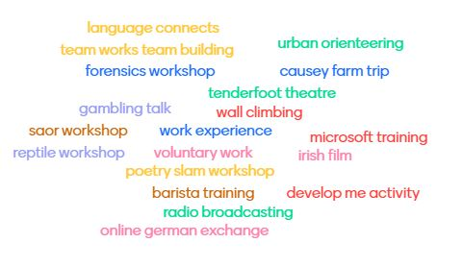
TY Activities

Slide 7
Eileen O’Gara
Guidance Counsellor

Slide 8
Agenda
Importance of subject choice in Transition Year
Factors to consider when choosing subjects
How students are supported to make their choices.
Careers Portal
Pathways for students after school
Entry requirements in Higher/Further Education
Focus on LC subjects & course requirements
Where to seek advice

Slide 9
Importance Of Subject Choice in Transition Year
Important that students choose subjects that they enjoy – 2 Year Senior Cycle.
Subjects may give students an insight into potential career choices.
Third Level Requirements
Subjects that are useful
Subjects/Grades that may be a requirement for further study

Slide 10
Factors to Consider when Choosing Subjects
Aptitude and Ability in the Subject
Interest and Enjoyment
Third Level Requirements
Specific Subject Requirements for Course
Potential to do Higher Level in Subject
Format of Exam- Projects/ Practicals/ Written Exams

Slide 11

How students are supported to make their choices
Guidance Classes – use of careersportal.ie & REACH programme
Teacher presentations to students – 12th March
Subject Booklet (will be on website)
Information Evening for Parents/Guardians & Students (PowerPoint will be on website)
Completion of Online Option Process

Slide 12


Careers Portal –REACH Programme
Access to self-assessment tools & subject choice information
www.careersportal.ie

Slide 13
REACH Account – www.careersportal.ie
Guidance Class – Students have completed interest tests that indicate subject/career areas students may be interested in.
There is a subject choice section in the REACH account where every subject available at Leaving Certificate is described under the following headings;
  Summary of Subject
  Grades Awarded in 2024
  Course Overview
  Course Content
  Exam Structure
  Career Possibilities
  Third Level Requirements
Every student in Transition Year has a REACH account.
Career Explorer also available.
Students will use CareersPortal throughout senior cycle.

Slide 14
Pathways Available After School
Higher Education
Further Education
Apprenticeships
Traineeships
Defence Forces
Direct to Employment

Slide 15
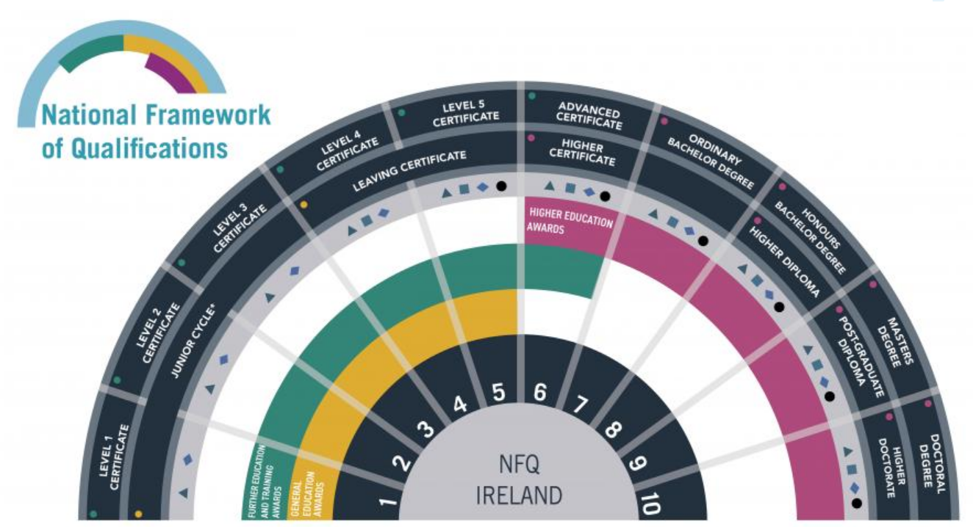

Slide 16
Higher Education
Minimum Entry Requirements – Level 8 (Generally)
Level 8 Degrees – UCD, Maynooth University, UCC, NUIG, RCSI, NCAD
2 H5 and 4 O6/H7 (to include following subjects: Irish, English, Maths*.
6 subjects
Generally.....
Please research
3rd language required for NUI for certain courses, (exemptions can be granted from Irish and/or language if requirements are met)

Slide 17
Higher Education
Minimum Entry Requirements – Level 8 (Generally)
Level 8 Degrees TCD, DCU, TU Dublin +...
2 H5 and 4 O6/H7 (sometimes 3H5 & 3 06) to include following subjects: Irish/English, Maths.
6 subjects
Generally.....
Please research
3rd language required if studying at third level.

Slide 18
Higher Education
Minimum Entry Requirements – Level 6/7
Level 6 (Higher Diploma) or 7 (Ordinary Level Degrees)
5 subjects, (in general)

Slide 19
Entry to Higher Education
Meet Minimum Entry Requirements
1
Meet Specific Subject/Grade Requirements
2
Have the required points
3
Note: CAO points based on 6 best subjects presented at Leaving Certificate
4

Slide 20
CAO Points System
Grade | Points | % | Grade | Points
H1 | 100 | 90-100 | O1 | 56
H2 | 88 | 80-89 | O2 | 46
H3 | 77 | 70-79 | O3 | 37
H4 | 66 | 60-69 | O4 | 28
H5 | 56 | 50-59 | O5 | 20
H6 | 46 | 40-49 | O6 | 12
H7 | 37 | 30-39 | O7 | 0
H8 | 0 | 0-29 | O8 | 0
25 Bonus Points for H6 and above in HL Maths

Slide 21
Further Education - Minimum Entry Requirements –Level 5/6 - No CAO Points Required
Further Education Colleges
QQI Level 5 Courses
5 O6s in Leaving Certificate
Portfolios (Art, Media related courses)
Auditions (Music, Media)/Interview
Students can progress to Higher Education upon successful completion of Level 5

Slide 22
Focus on Leaving Cert Subjects & Course Requirements
Required subjects
Useful subjects

Slide 23
CORE SUBJECT- IRISH
Higher Level Irish (H4) is required for Primary Teaching and to study Irish at University
Irish is required for entry into UCD, Maynooth, NUIG, UCC, NCAD
Some students are exempt

Slide 24
CORE SUBJECT- ENGLISH
Essential subject for college entry
Grade required: O6/H7
Technological Universities/ ITs will accept Irish/English
Speech and Language Therapy, Journalism, Creative Digital Media, Media Courses require Higher Level English
Essential for Employment/ Apprenticeships

Slide 25
CORE SUBJECT-MATHEMATICS
Necessary for entry to most college courses
Examples where Higher Level Maths is required- Engineering- H4, Computer Science (TCD)-H4, Computational Thinking (Maynooth University) -H2, Actuarial Maths (DCU)-H3, Theoretical Physics H3 (TCD), Maths H3 (TCD), Theoretical Physics & Maths H2 (MU)
Can be used as one subject that will meet requirements for 2 Science in TCD – please check individual courses.

Slide 26
Bonus Points in Maths
25 Bonus Points for a H1-H6
Potential Leaving Cert Points- 625

Slide 27
Third Language as Option Subject
Minimum Entry requirement for UCD, Maynooth University, NUIG, UCC, NCAD, RCSI
Note: Some courses have removed language requirement
Option to study other languages at Higher Education -International Business/ Hospitality
Please research

Slide 28
Summary of Language Requirements in UCD & Maynooth University 2024/25
See links below with more detailed information on language requirements for courses
https://www.ucd.ie/registry/t4media/LC_Summary_ER_2025.pdf
https://www.maynoothuniversity.ie/sites/default/files/assets/document/FINAL%20Minimum%20Requirements%20Booklet%202024-2025%2021.10.24.pdf
Link about importance of studying languages
https://languagesconnect.ie/at-third-level/

Slide 29
Moving Modern Foreign Languages (MFL) from core to options
Most students will continue to student either French or German
Some students will also take a non -curricular language (Polish, Russian, Romanian, etc.) Languages at Senior Cycle | Languages Connect
If you are thinking of dropping French/German, be sure to do your research carefully so you do not restrict your choices of college course or future careers.
Be sure you list your options based on the level of importance of getting each subject.

Slide 30
Note: this is NOT how your option lines will be!
Current 5th Year Option Lines 2024
Line 1 | Biology | Engineering | Biology | Home Economics | Music | LCPE | Physics | Accounting
Line 2 | DCG | Engineering | Const Studies | Biology | History | Geography | Business | Computer Science
Line 3 | Business | Technology | Biology | Art | Chemistry | Geography | Religious Education
Your 5th Year Option Lines for 2025-27
Line 1 | Subject 1 | Subject 2 | Subject 3 | Subject 4 | Subject 5 | Subject 6 | French? | French?
Line 2 | Subject 1 | Subject 2 | Subject 3 | Subject 4 | Subject 5 | Subject 6 | German? | French?
Line 3 | Subject 1 | Subject 2 | Subject 3 | Subject 4 | Subject 5 | Subject 6 | German? | French?
Line 4 | Subject 1 | Subject 2 | Subject 3 | Subject 4 | Subject 5 | Subject 6 | Subject 7 | French?

Slide 31
Examples of Courses that Require a Science Subject
Nursing
Science
Medicine
Physiotherapy
Athletic Training & Therapy
Geography can meet science requirement for some courses (TCD) – please research.

Slide 32
Examples of Subject/Grade Requirements for Courses
Theoretical Physics, TCD | H3 Physics
International Languages | H3/H4 in Language
Veterinary Medicine, UCD | H5 Chemistry + 60 hours animal handling experience
Dietetics, TUD Law, TU Dublin Journalism, Communication Studies, Multimedia Engineering, UCD, TCD, TU Dublin | H4 Chemistry H4 English H4 English H4 Maths
Architectural Technology, TUD | H4 Art, Construction, DCG, Engineering, Technology

Slide 33
Examples of Useful Subjects for Careers – List is not in any way exhaustive (includes subjects available in LCC)
Careers portal have career links for each subject
Design/Architecture | DCG/Art
Finance | Maths/Applied Maths/Accountancy
Media Studies | English, Politics & Society, History
Engineering | Engineering, Maths, Physics, Applied Maths, Technology
Trade Apprenticeships | Construction Studies, Engineering, DCG, Technology
Healthcare | Biology, Physics, Chemistry
Computer Science | Maths, Computer Science, Science

Slide 34
Key Point to Remember
Choose subjects to allow for a change of mind regarding career choice in the next two years

Slide 35
Conclusion
Reflect on your interests, ability in subject and all possible career interests
Complete form in order of preference in consultation with parents/guardians
Speak to teachers and Guidance Counsellors
Do your research – there is lots of information available. Make an informed choice.
Every effort made to give students first option
Students career interests taken into account

Slide 36
Where To Seek Advice
Subject Teachers
Guidance Counsellors
Parents/Guardians & Siblings/Friends
Looking at Leaving Certificate Text Books
Online information – Careers Portal & College Websites

Slide 37
Resources/ Questions
www.careersportal.ie
www.qualifax.ie
www.examinations.ie
If you have questions regarding courses/ training or choosing particular subjects, please email:
Eileenogara@lucancc.ie
Lucan CC website for subject videos & information booklet.
www.ncca.ie
College websites
Apprenticeships.ie

Slide 38
Kevin McGowan
Deputy Principal

Slide 39
Accessing
VSware as a parent
(not as a student)
As parents of next year’s 5th year students, you are requested to choose subject options via your parental VSware account which all parents have access to – students cannot do this.
In order to complete this option process, you will need to visit our VSware website which is www.lucancc.vsware.ie (VSware is best accessed through Google Chrome).
A link will be sent to you on the SCHOOL APP when options are open for completion.
Start off by entering your username and password and click 'sign in'.
If you have forgotten your parental VSware password, please click 'Create/Reset Password' at the bottom of the VSware login page and follow the steps.
The school cannot issue passwords (GDPR)
If you are having any difficulties accessing your VSware account please contact admin@lucancc.ie

Slide 40

Entering options using VSware
You must proceed to enter each subject in order of preference using the drop-down menu (1 – 7 in order of preference).
There is a video available at https://vsware.wistia.com/medias/kr62eqh02z that will show you exactly how it is done.
Options entry on VSware – instructions to follow in the next few weeks.
You can revisit and change options at any time during the window.
Students will be assigned classes based on available space if the online process is not completed (or incomplete).

Slide 41

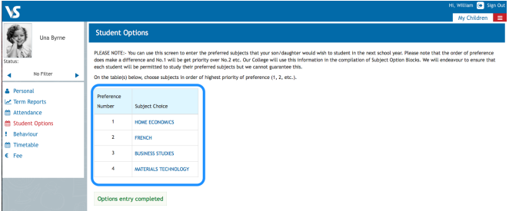
Screenshot of VSware Options – must enter top 7 subjects
Choose 7 subjects 1-7 in order of preference.
Top priority must be placed at No. 1

Slide 42
Core 5th Year Subjects:
Core Subjects (all students study)
  Gaeilge/Irish (for examination unless DES exempted)
  English
  Maths
  Plus:
  Non-exam Religious Education including RSE
  Non-exam Physical Education
  SPHE
  You must then choose 4 option subjects

Slide 43
Option Subjects
21 Subject Options
Select 7
Students will be offered 4 option subjects
  Geography​
  German
  History​
  Home Economics​
  Music​
  Physics​
  Physical Education (LCPE)​
  Politics & Society​
  Religion​
  Technology​
  Accounting​
  Applied Maths
  Art​
  Biology​
  Business​
  Chemistry​
  Computer Science​
  Construction Studies​
  DCG​
  Engineering​
  French

Slide 44

Important points about options
Every effort is made to allocate students subjects based on their preferences
Due to resource issues (size of classes, staff, specialist classrooms and scheduling clashes) it is not possible to give everyone their 1, 2, 3,4.
In general, 90% students will get No.1, 75% No.2 and approximately 66% No.3
Therefore student's 5th, 6th, 7th and choices are crucially important
Important that you reflect before deciding your preference on student interest and aptitude, possible career options
Don't worry! Process for addressing option issues upon start-up in August 2025 – any subject option change must be made before the end of September and are contingent on available spaces

Slide 45

Additional option subject
The LCVP is a Leaving Certificate with a focus on enterprise and preparation for working life. This two-year programme combines the academic strengths of the Leaving Certificate with a dynamic focus on self-directed learning, enterprise, work and the community
Currently may run inside or outside the timetable. It will depend on the demand for the subject.
We will seek expressions of interest at a later date.

Slide 46

Information Booklet

Slide 47

Questions & Answers

Slide 48

Thank you for attending tonight.

