Slide 1

5th year
Options
Information Evening
Wednesday 11th March 2026
6:30 pm

Slide 2
Stephen Brett
Principal

Slide 3


Welcome to tonight’s event

Slide 4
Tonight's speakers:
Edel McManus (Guidance Department) - choosing subjects
Kevin McGowan (Deputy Principal) - the online options process
Questions

Slide 5
Edel McManus
Guidance Counsellor

Slide 6
Agenda
Importance of subject choice in Transition Year
Factors to consider when choosing subjects
How students are supported to make their choices.
Careers Portal
Pathways for students after school
Entry requirements in Higher/Further Education
Focus on LC subjects & course requirements
Where to seek advice

Slide 7
Importance Of Subject Choice in Transition Year
Important that students choose subjects that they enjoy – 2 Year Senior Cycle.
Subjects may give students an insight into potential career choices.
Third Level Requirements
Subjects that are useful
Subjects/Grades that may be a requirement for further study

Slide 8
Factors to Consider when Choosing Subjects
Aptitude and Ability in the Subject
Interest and Enjoyment
Third Level Requirements
Specific Subject Requirements for Course
Potential to do Higher Level in Subject
Format of Exam- Projects/ Practicals/ Written Exams

Slide 9

How students are supported to make their choices
Guidance Classes – use of careersportal.ie & REACH programme. CAT testing and feedback.
Teacher presentations to students – Wednesday 11th March '26
Subject Booklet (will be on website)
Information Evening for Parents/Guardians & Students (PowerPoint will be on website)
Completion of Online Option Process

Slide 10
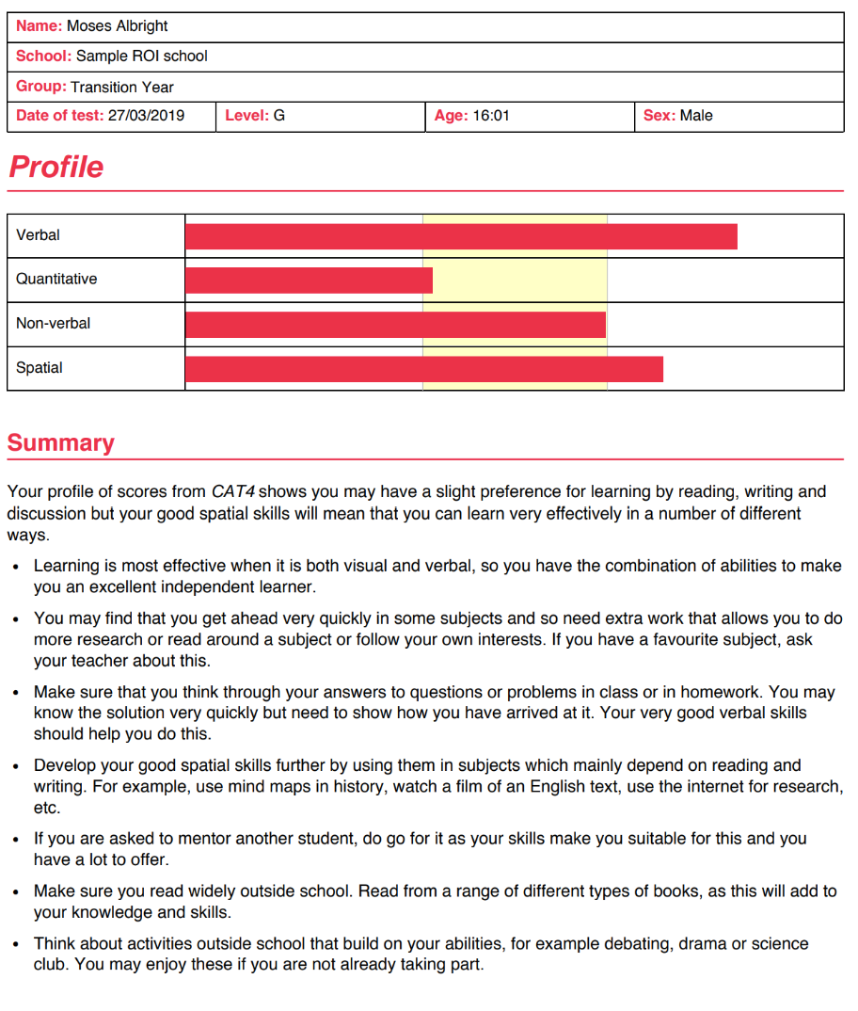
CAT Testing & Feedback

Slide 11


Careers Portal –REACH Programme
Access to self-assessment tools & subject choice information
www.careersportal.ie

Slide 12
REACH Account – www.careersportal.ie
Guidance Class – Students have completed interest tests that indicate subject/career areas students may be interested in.
There is a subject choice section in the REACH account where every subject available at Leaving Certificate is described under the following headings;
  Summary of Subject
  Grades Awarded in 2024
  Course Overview
  Course Content
  Exam Structure
  Career Possibilities
  Third Level Requirements
Every student in Transition Year has a REACH account.
Career Explorer also available.
Students will use CareersPortal throughout senior cycle.

Slide 13
Pathways Available After School
Higher Education
Further Education
Apprenticeships
Traineeships
Defence Forces
Direct to Employment

Slide 14
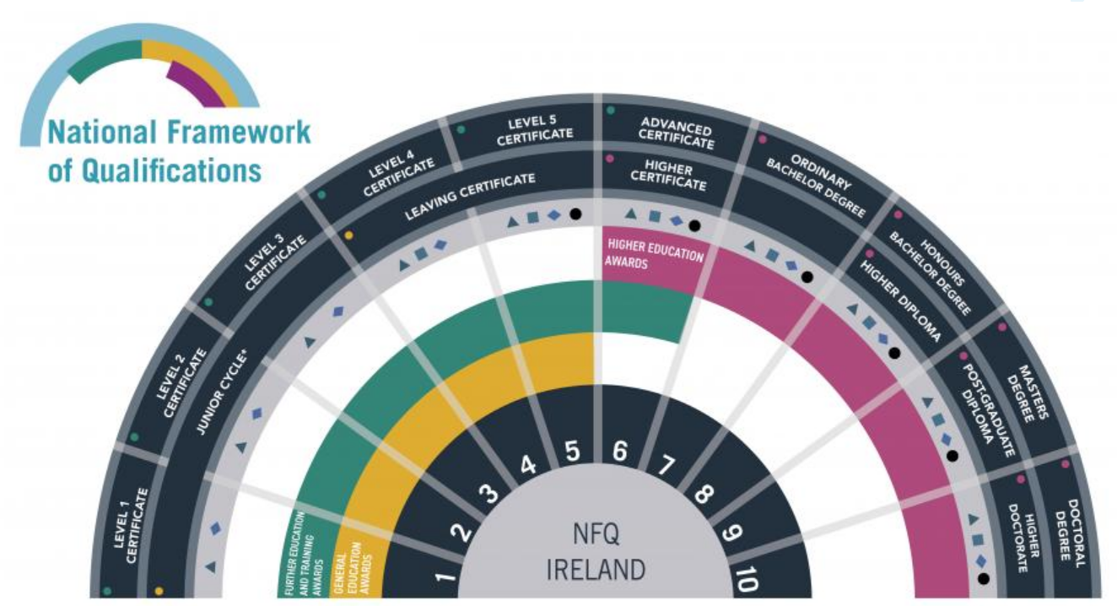

Slide 15
Higher Education
Minimum Entry Requirements – Level 8 (Generally)
Level 8 Degrees – UCD, Maynooth University, UCC, NUIG, RCSI, NCAD
2 H5 and 4 O6/H7 (to include following subjects: Irish, English, Maths*.
6 subjects
Generally.....
Please research
3rd language required for NUI for certain courses, (exemptions can be granted from Irish and/or language if requirements are met)

Slide 16
Higher Education
Minimum Entry Requirements – Level 8 (Generally)
Level 8 Degrees TCD, DCU, TU Dublin +...
2 H5 and 4 O6/H7 (sometimes 3H5 & 3 06) to include following subjects: Irish/English, Maths.
6 subjects
Generally.....
Please research
3rd language required if studying at third level.

Slide 17
Higher Education
Minimum Entry Requirements – Level 6/7
Level 6 (Higher Diploma) or 7 (Ordinary Level Degrees)
5 subjects, (in general)

Slide 18
Entry to Higher Education
Meet Minimum Entry Requirements
1
Meet Specific Subject/Grade Requirements
2
Have the required points
3
Note: CAO points based on 6 best subjects presented at Leaving Certificate
4

Slide 19
CAO Points System
Grade | Points | % | Grade | Points
H1 | 100 | 90-100 | O1 | 56
H2 | 88 | 80-89 | O2 | 46
H3 | 77 | 70-79 | O3 | 37
H4 | 66 | 60-69 | O4 | 28
H5 | 56 | 50-59 | O5 | 20
H6 | 46 | 40-49 | O6 | 12
H7 | 37 | 30-39 | O7 | 0
H8 | 0 | 0-29 | O8 | 0
25 Bonus Points for H6 and above in HL Maths

Slide 20
Further Education - Minimum Entry Requirements –Level 5/6 - No CAO Points Required
Further Education Colleges
QQI Level 5 Courses
5 O6s in Leaving Certificate
Portfolios (Art, Media related courses)
Auditions (Music, Media)/Interview
Students can progress to Higher Education upon successful completion of Level 5

Slide 21
Focus on Leaving Cert Subjects & Course Requirements
Required subjects
Useful subjects

Slide 22
CORE SUBJECT- IRISH
Higher Level Irish (H4) is required for Primary Teaching and to study Irish at University
Irish is required for entry into UCD, Maynooth, NUIG, UCC, NCAD
Some students are exempt

Slide 23
CORE SUBJECT- ENGLISH
Essential subject for college entry
Grade required: O6/H7
Technological Universities/ ITs will accept Irish/English
Speech and Language Therapy, Journalism, Creative Digital Media, Media Courses require Higher Level English
Essential for Employment/ Apprenticeships

Slide 24
CORE SUBJECT-MATHEMATICS
Necessary for entry to most college courses
Examples where Higher Level Maths is required- Engineering- H4, Computer Science (TCD)-H4, Computational Thinking (Maynooth University) -H2, Actuarial Maths (DCU)-H3, Theoretical Physics H3 (TCD), Maths H3 (TCD), Theoretical Physics & Maths H2 (MU)
Can be used as one subject that will meet requirements for 2 Science in TCD – please check individual courses.

Slide 25
Bonus Points in Maths
25 Bonus Points for a H1-H6
Potential Leaving Cert Points- 625

Slide 26
Third Language as Option Subject
Minimum Entry requirement for UCD, Maynooth University, NUIG, UCC, NCAD, RCSI
Note: Some courses have removed language requirement
Option to study other languages at Higher Education -International Business/ Hospitality
Please research

Slide 27
Summary of Language Requirements in UCD & Maynooth University 2024/25
See links below with more detailed information on language requirements for courses
https://www.ucd.ie/registry/t4media/LC_Summary_ER_2025.pdf
https://www.maynoothuniversity.ie/sites/default/files/assets/document/FINAL%20Minimum%20Requirements%20Booklet%202024-2025%2021.10.24.pdf
Link about importance of studying languages
https://languagesconnect.ie/at-third-level/

Slide 28
Moving Modern Foreign Languages (MFL) from core to options
Most students will continue to student either French or German
Some students will also take a non -curricular language (Polish, Russian, Romanian, etc.) Languages at Senior Cycle | Languages Connect
If you are thinking of dropping French/German, be sure to do your research carefully so you do not restrict your choices of college course or future careers.
Be sure you list your options based on the level of importance of getting each subject.

Slide 29
Examples of Courses that Require a Science Subject
Nursing
Science
Medicine
Physiotherapy
Athletic Training & Therapy
Geography can meet science requirement for some courses (TCD) – please research.

Slide 30
Examples of Subject/Grade Requirements for Courses
Theoretical Physics, TCD | H3 Physics
International Languages | H3/H4 in Language
Veterinary Medicine, UCD | H5 Chemistry + 60 hours animal handling experience
Dietetics, TUD Law, TU Dublin Journalism, Communication Studies, Multimedia Engineering, UCD, TCD, TU Dublin | H4 Chemistry H4 English H4 English H4 Maths
Architectural Technology, TUD | H4 Art, Construction, DCG, Engineering, Technology

Slide 31
Examples of Useful Subjects for Careers – List is not in any way exhaustive (includes subjects available in LCC)
Careers portal have career links for each subject
Design/Architecture | DCG/Art
Finance | Maths/Applied Maths/Accountancy
Media Studies | English, Politics & Society, History
Engineering | Engineering, Maths, Physics, Applied Maths, Technology
Trade Apprenticeships | Construction Studies, Engineering, DCG, Technology
Healthcare | Biology, Physics, Chemistry
Computer Science | Maths, Computer Science, Science

Slide 32
Key Point to Remember
Choose subjects to allow for a change of mind regarding career choice in the next two years

Slide 33
Conclusion
Reflect on your interests, ability in subject and all possible career interests
Complete form in order of preference in consultation with parents/guardians
Speak to teachers and Guidance Counsellors
Do your research – there is lots of information available. Make an informed choice.
Every effort made to give students first option
Students career interests taken into account

Slide 34
Where To Seek Advice
Subject Teachers
Guidance Counsellors
Parents/Guardians & Siblings/Friends
Looking at Leaving Certificate Text Books
Online information – Careers Portal & College Websites

Slide 35
Resources/ Questions
www.careersportal.ie
www.qualifax.ie
www.examinations.ie
If you have questions regarding courses/ training or choosing particular subjects, please email:
Eileenogara@lucancc.ie
Lucan CC website for subject videos & information booklet.
www.ncca.ie
College websites
Apprenticeships.ie

Slide 36
Kevin McGowan
Deputy Principal

Slide 37
Accessing
VSware as a parent
(not as a student)
As parents of next year’s 5th year students, you are requested to choose subject options via your parental VSware account which all parents have access to – students cannot do this.
In order to complete this option process, you will need to visit VSware which is accessible on www.lucancc.vsware.ie or via the school app
A link will be sent to you on the SCHOOL APP when options are open for completion.
If you have forgotten your parental VSware password, please click 'Create/Reset Password' at the bottom of the VSware login page and follow the steps.
The school cannot issue passwords (GDPR)
If you are having any difficulties accessing your VSware account please contact admin@lucancc.ie

Slide 38

Entering options using VSware
You must proceed to enter each subject in order of preference using the drop-down menu (1 – 7 in order of preference).
There is a video available at https://tinyurl.com/Options2026 that will show you exactly how it is done.
Options entry on VSware – instructions to follow in the next few weeks.
You can revisit and change options at any time during the window.
Students will be assigned classes based on available space if the online process is not completed (or incomplete).

Slide 39

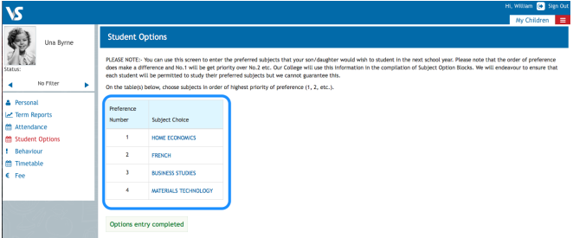
Screenshot of VSware Options – must enter top 7 subjects
Choose 7 subjects 1-7 in order of preference.
Top priority must be placed at No. 1

Slide 40
Core 5th Year Subjects:
Core Subjects (all students study)
  Gaeilge/Irish (for examination unless DES exempted)
  English
  Maths
  Plus:
  Non-exam Religious Education including RSE
  Non-exam Physical Education
  SPHE
  You must then choose 4 option subjects

Slide 41
Option Subjects
21 Subject Options
Select 7
Students will be offered 4 option subjects
  Geography​
  German
  History​
  Home Economics​
  Music​
  Physics​
  Physical Education (LCPE)​
  Politics & Society​
  Religion​
  Technology​
  Accounting​
  Applied Maths
  Art​
  Biology​
  Business​
  Chemistry​
  Computer Science​
  Construction Studies​
  DCG​
  Engineering​
  French

Slide 42
5th Year Option Lines 2026
Line 1 | Subject 1 | Subject 2 | Subject 3 | Subject 4 | Subject 5 | Subject 6 | French? | French?
Line 2 | Subject 1 | Subject 2 | Subject 3 | Subject 4 | Subject 5 | Subject 6 | German? | French?
Line 3 | Subject 1 | Subject 2 | Subject 3 | Subject 4 | Subject 5 | Subject 6 | German? | French?
Line 4 | Subject 1 | Subject 2 | Subject 3 | Subject 4 | Subject 5 | Subject 6 | Subject 7 | French?

Slide 43

Important points about options
Every effort is made to allocate students subjects based on their preferences
Due to resource issues (size of classes, staff, specialist classrooms and scheduling clashes) it is not possible to give everyone their 1, 2, 3,4.
In general, 90%+ students will get No.1, 80%+ No.2 and approximately 70+% No.3 etc
Therefore student's 5th, 6th, 7th and choices are crucially important
Important that you reflect before deciding your preference on student interest and aptitude, possible career options
Don't worry! Process for addressing option issues upon start-up in August 2026 – any subject option change must be made before the end of September and are contingent on available spaces

Slide 44

Information Booklet

Slide 45

Thank you for attending tonight.

